Slide 1
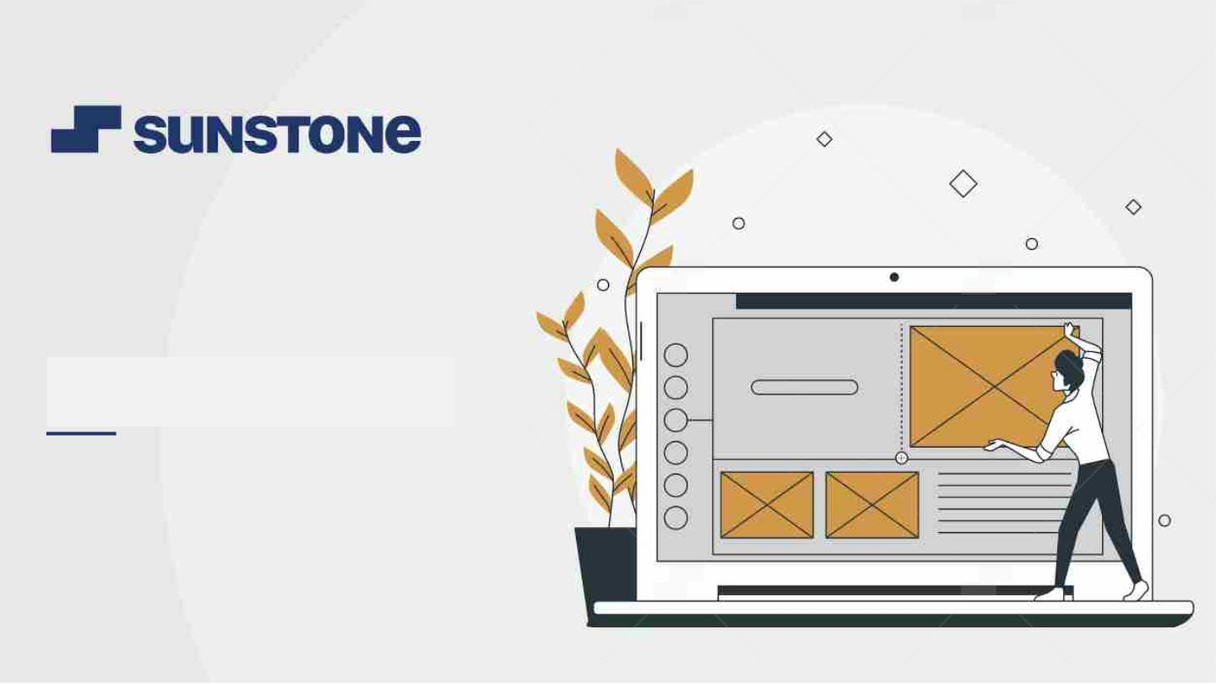
APPLICATION FOR GROCERY
DELIVERY
Task - 1

Slide 2
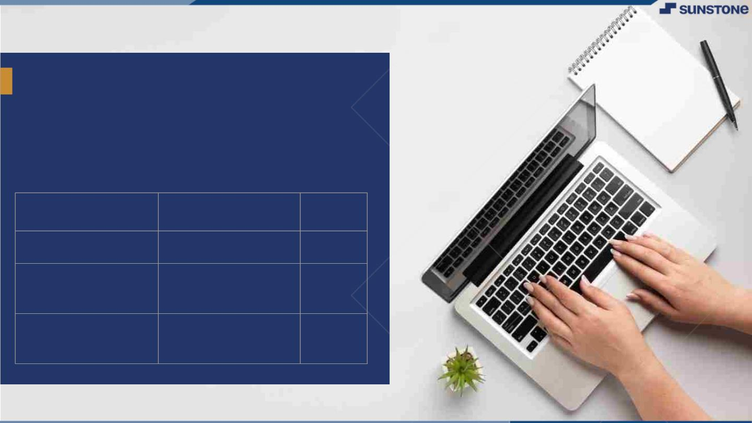
ApplicationꢀForꢀGroceryꢀ
Deliveryꢀ
TheꢀGroceryꢀDeliveryꢀApplicationꢀisꢀaꢀweb-basedꢀapplicationꢀthatꢀ
enablesꢀusersꢀtoꢀorderꢀgroceriesꢀonlineꢀandꢀhaveꢀthemꢀdeliveredꢀ
toꢀtheirꢀdoorstep.ꢀThisꢀSRSꢀdocumentꢀprovidesꢀanꢀoverviewꢀofꢀtheꢀ
functionality,ꢀfeatures,ꢀandꢀrequirementsꢀforꢀtheꢀapplication
LMS Username
Name
Batch
2101a235
2101a231
KISHORE V
A23
A23
ANTONY STINVA
DITTO.S
2101a2321
SARAVANA
KUMAR
A23

Slide 3
SOFTWARE REQUIREMENTS SPECIFICATION FOR
APPLICATION FOR GROCERY DELIVERY PREPARED BY:-
Kishore.V
Antony Stinva Ditto.S
Saravana Kumar.M
TheꢀGroceryꢀDeliveryꢀApplicationꢀisꢀaꢀweb-basedꢀapplicationꢀthatꢀ
enablesꢀusersꢀtoꢀorderꢀgroceriesꢀonlineꢀandꢀhaveꢀthemꢀdeliveredꢀ
toꢀtheirꢀdoorstep.ꢀThisꢀSRSꢀdocumentꢀprovidesꢀanꢀoverviewꢀofꢀtheꢀ
functionality,ꢀfeatures,ꢀandꢀrequirementsꢀforꢀtheꢀapplication

Slide 4
1.Introduction
The Grocery Delivery Application is a web-based application that enables users to order groceries online and have them delivered to their doorstep. This SRS document provides an overview of the functionality, features, and requirements for the application.
2.System Requirements
The Grocery Delivery Application will require the following hardware and software:
A web server to host the application
A database management system to store user and product information
An internet connection for users to access the application
A computer or mobile device with a web browser to access the application
TheꢀGroceryꢀDeliveryꢀApplicationꢀisꢀaꢀweb-basedꢀapplicationꢀthatꢀ
enablesꢀusersꢀtoꢀorderꢀgroceriesꢀonlineꢀandꢀhaveꢀthemꢀdeliveredꢀ
toꢀtheirꢀdoorstep.ꢀThisꢀSRSꢀdocumentꢀprovidesꢀanꢀoverviewꢀofꢀtheꢀ
functionality,ꢀfeatures,ꢀandꢀrequirementsꢀforꢀtheꢀapplication

Slide 5
3.Functional Requirements
3.1 Registration and Login
Users can create an account with the application by providing orstep.ꢀThisꢀSRSꢀdocumentꢀprovidesꢀanꢀoverviewꢀofꢀtheꢀ
functionality,ꢀfeatures,ꢀandꢀrequirementsꢀforꢀtheꢀapplication
their personal information, including name, address, email, and phone number.
Users can log in to the application using their email and password.
3.2 Product Catalogue
The application should provide users with a list of available products, including their prices, descriptions, and images.
The application should enable users to search for specific products and filter products by category, brand, or price range.

Slide 6
TheꢀGroceryꢀDeliveryꢀApplicationꢀisꢀaꢀweb-basedꢀapplicationndꢀ
haveꢀthemꢀdeliveredꢀ
toꢀtheirꢀdoorstep.ꢀThisꢀSRSꢀdocumentꢀprovidesꢀanꢀoverviewꢀofꢀtheꢀ
functionality,ꢀfeatures,ꢀandꢀrequirementsꢀforꢀtheꢀapplication
3.3 Shopping Cart
Users can add products to their shopping cart.
Users can modify the contents of their shopping cart, including updating quantities and removing items.
Users can view the total cost of their shopping cart, including any taxes or fees.
3.4 Checkout and Payment
Users can checkout and provide their delivery address and payment information. The application should support multiple payment options,
including credit card, debit card, and online wallets.
The application should calculate and display the final cost of the order, including any taxes or fees.

Slide 7
TheꢀGroceryꢀDeliveryꢀApplicationꢀisꢀaꢀweb-basedꢀapplicationndꢀ
haveꢀthemꢀdeliveredꢀ
toꢀtheirꢀdoorstep.ꢀThisꢀSRSꢀdocumentꢀprovidesꢀanꢀoverviewꢀofꢀtheꢀ
functionality,ꢀfeatures,ꢀandꢀrequirementsꢀforꢀtheꢀapplication
3.5 Order Tracking
Users can track the status of their orders, including order confirmation, packing, and delivery.
Users can receive notifications about the status of their orders via email or SMS.
4.Non-functional Requirements
4.1 Performance
The application should be responsive and load quickly.
The application should be able to handle a high volume of traffic and transactions.

Slide 8
TheꢀGroceryꢀDeliveryꢀApplicationꢀisꢀaꢀweb-basedꢀapplicationndꢀ
haveꢀthemꢀdeliveredꢀ
toꢀtheirꢀdoorstep.ꢀThisꢀSRSꢀdocumentꢀprovidesꢀanꢀoverviewꢀofꢀtheꢀ
functionality,ꢀfeatures,ꢀandꢀrequirementsꢀforꢀtheꢀapplication
4.2 Security
User data should be securely stored in the database.
The application should use encryption to protect sensitive user data, such as passwords and payment information.
4.3 Usability
The application should be easy to use and navigate.
The application should be accessible on different devices and web browsers.

Slide 9
TheꢀGroceryꢀDeliveryꢀApplicationꢀisꢀaꢀweb-basedꢀapplicationndꢀ
haveꢀthemꢀdeliveredꢀ
toꢀtheirꢀdoorstep.ꢀThisꢀSRSꢀdocumentꢀprovidesꢀanꢀoverviewꢀofꢀtheꢀ
functionality,ꢀfeatures,ꢀandꢀrequirementsꢀforꢀtheꢀapplication
Conclusion
The Grocery Delivery Application will provide a convenient and user-friendly way for customers to order groceries online and have them delivered to their doorstep. The application will require a web server, a database management system, and an internet connection to function. The application will have several functional requirements, including registration and login, product catalogue, shopping cart, checkout and payment, and order tracking. The application will also have non-functional requirements, including performance, security, and usability.

Slide 10
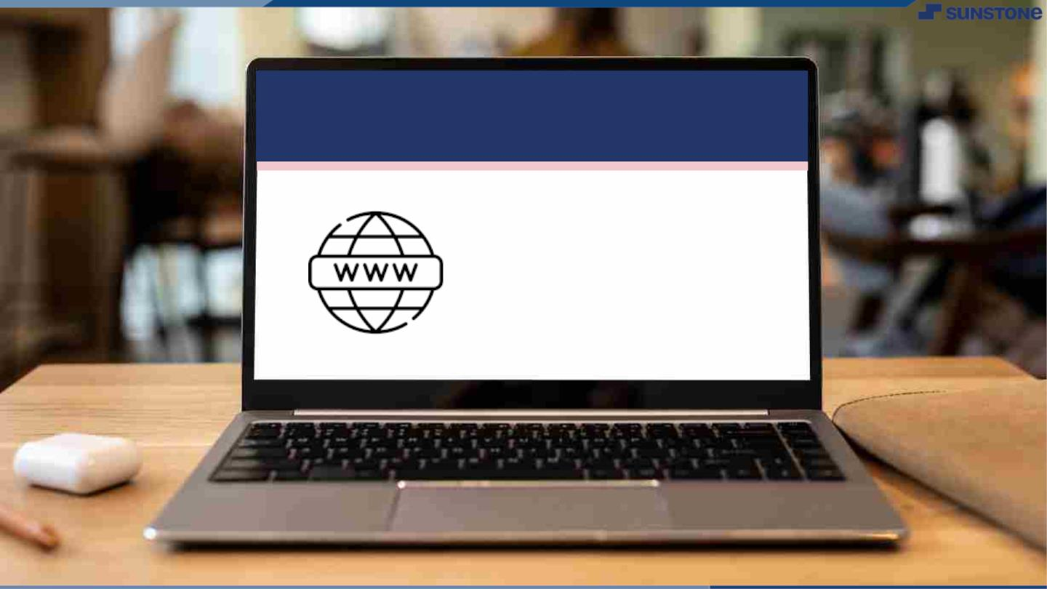
Submission Github
https://github.com/Kishoreragav/
srs-for-delivery.git

Slide 11
